Slide 1
Advanced Digital Image Processing
Filters
Slide Credits:
Dr. Sk. Md. Masudul Ahsan
Professor, Dept. of CSE
KUET
Md. Ferdous
Lecturer, Dept. of CSE, BSMRSTU

Slide 2
What we will learn today?
Image sampling and quantization
Image histograms
Images as functions
Linear systems (filters)
Convolution and correlation
Some background reading:
Forsyth and Ponce, Computer Vision, Chapter 7

Slide 3
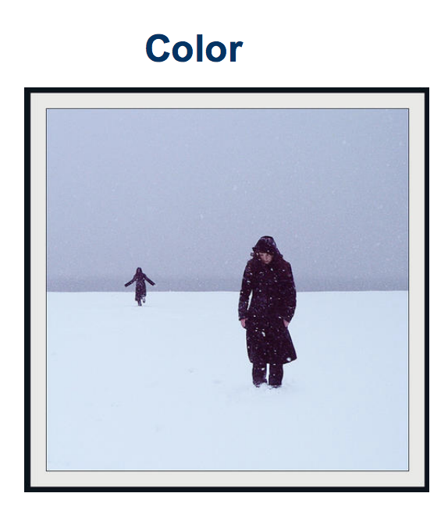
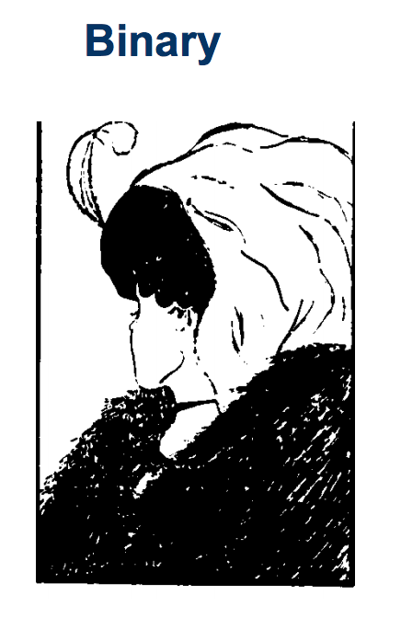
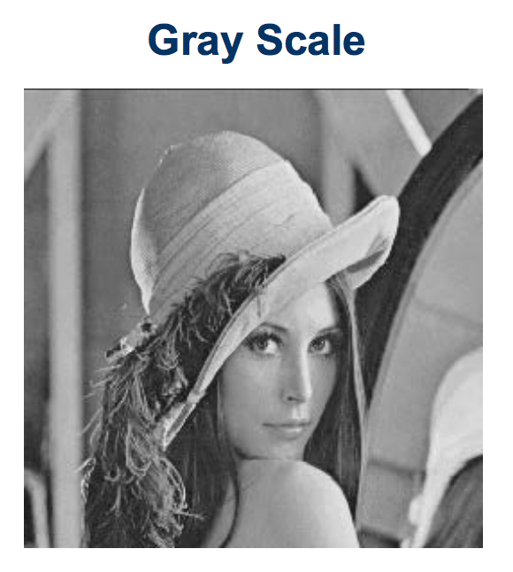
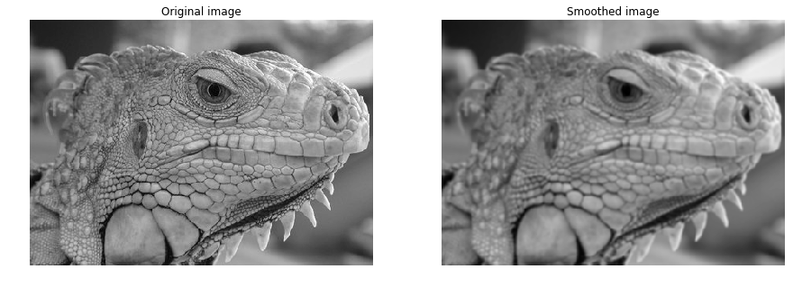
Types of Images

Slide 4
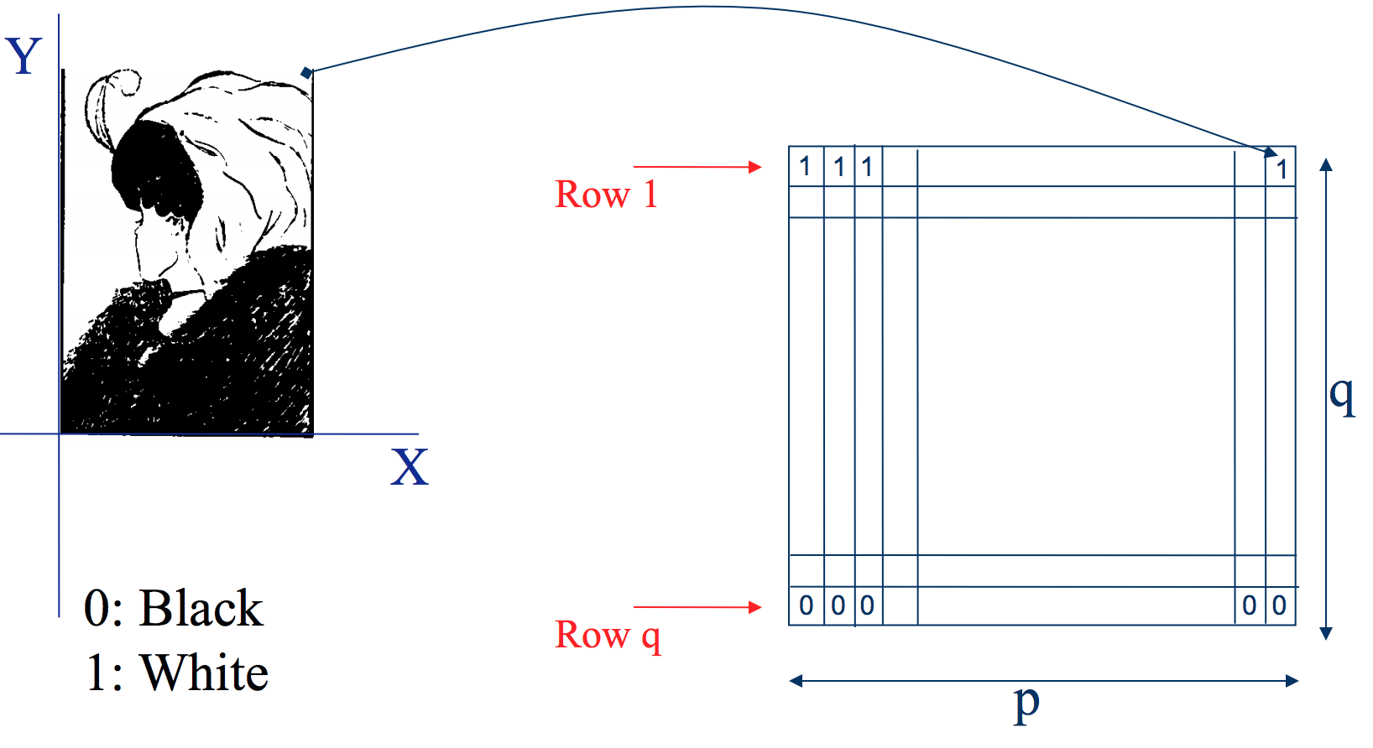
Binary image representation
Slide credit: Ulas Bagci

Slide 5
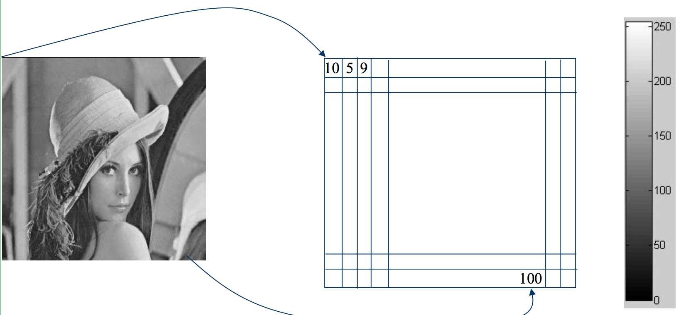
Grayscale image representation
Slide credit: Ulas Bagci

Slide 6
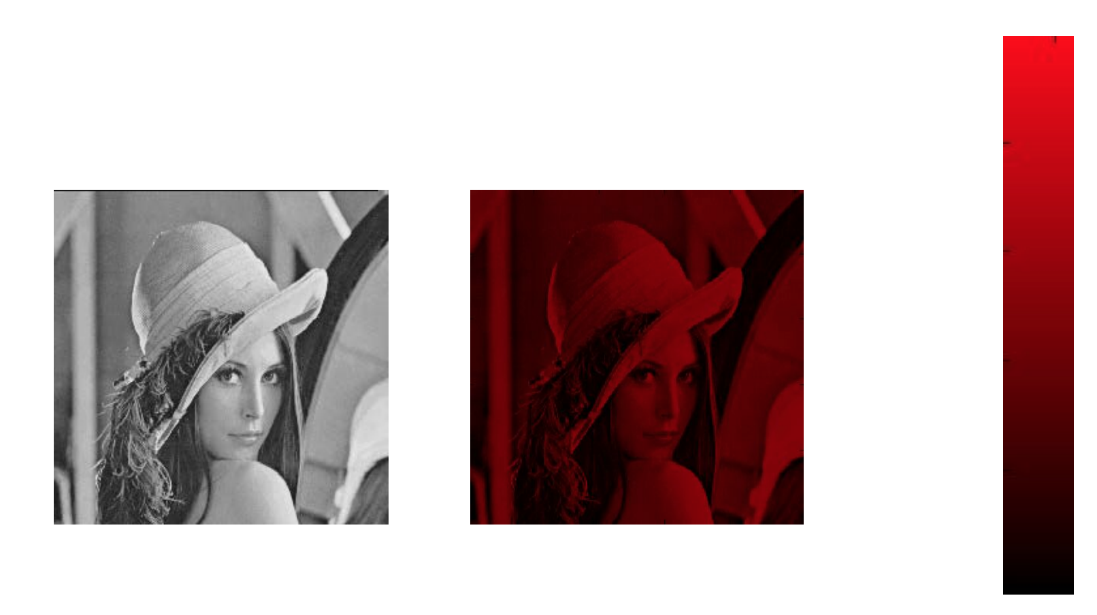
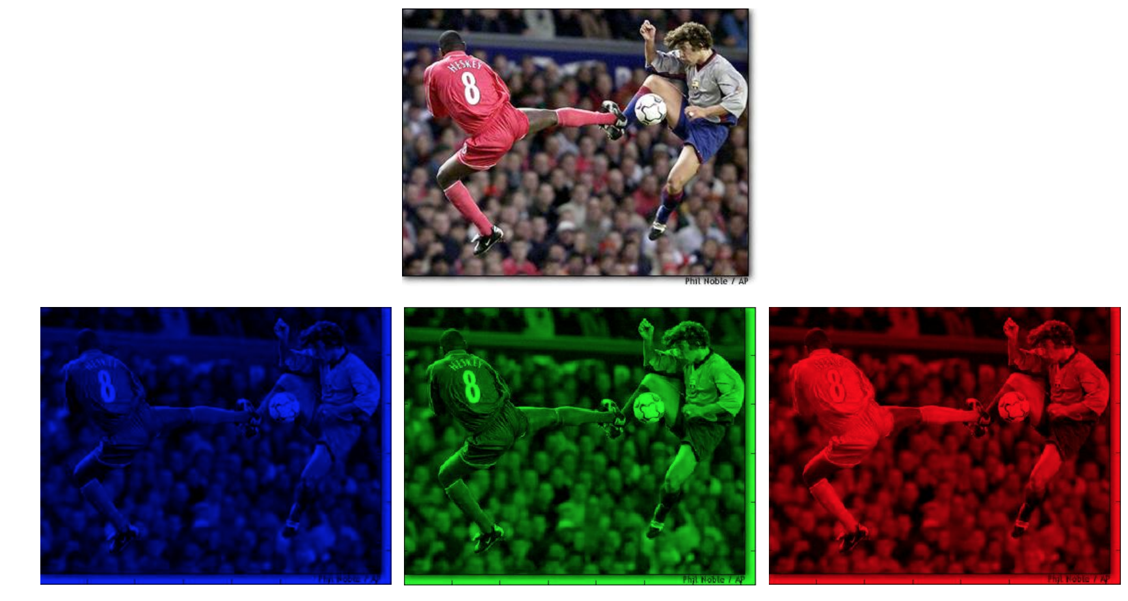
Color Image - one channel

Slide 7
Color image representation
Slide credit: Ulas Bagci

Slide 8
Images are Sampled and Quantized
An image contains discrete number of pixels
A simple example
Pixel value:
“grayscale”
(or “intensity”): [0,255]
75
231
148
Notes:
Last time: Images as Matrices
intensity
temperature
depth

Slide 9
Images are Sampled and Quantized
An image contains discrete number of pixels
A simple example
Pixel value:
“grayscale”
(or “intensity”): [0,255]
“color”
RGB: [R, G, B]
Lab: [L, a, b]
HSV: [H, S, V]
[90, 0, 53]
[249, 215, 203]
[213, 60, 67]

Slide 10
With this loss of information (from sampling and quantization), Can we still use images for useful tasks?

Slide 11
What we will learn today?
Image sampling and quantization
Image histograms
Images as functions
Linear systems (filters)
Convolution and correlation
Some background reading:
Forsyth and Ponce, Computer Vision, Chapter 7

Slide 12
Histogram
Histogram of an image provides the frequency of the brightness (intensity) value in the image.
def histogram(im):
h = np.zeros(255)
for row in im.shape[0]:
for col in im.shape[1]:
val = im[row, col]
h[val] += 1

Slide 13
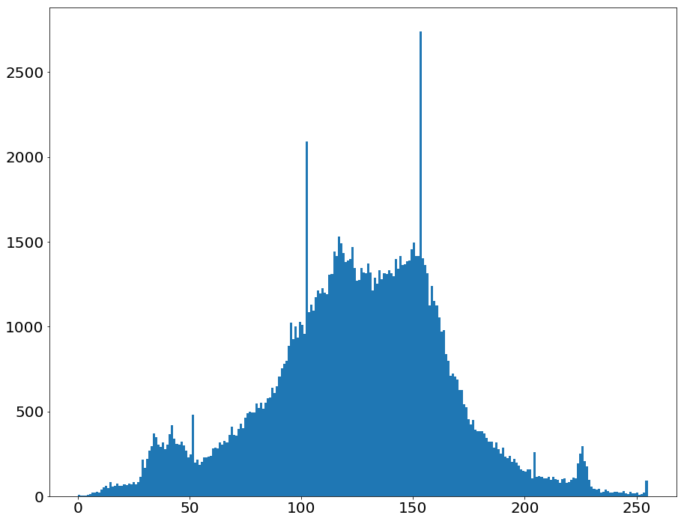
Histogram
Histogram captures the distribution of gray levels in the image.
How frequently each gray level occurs in the image
Q

Slide 14
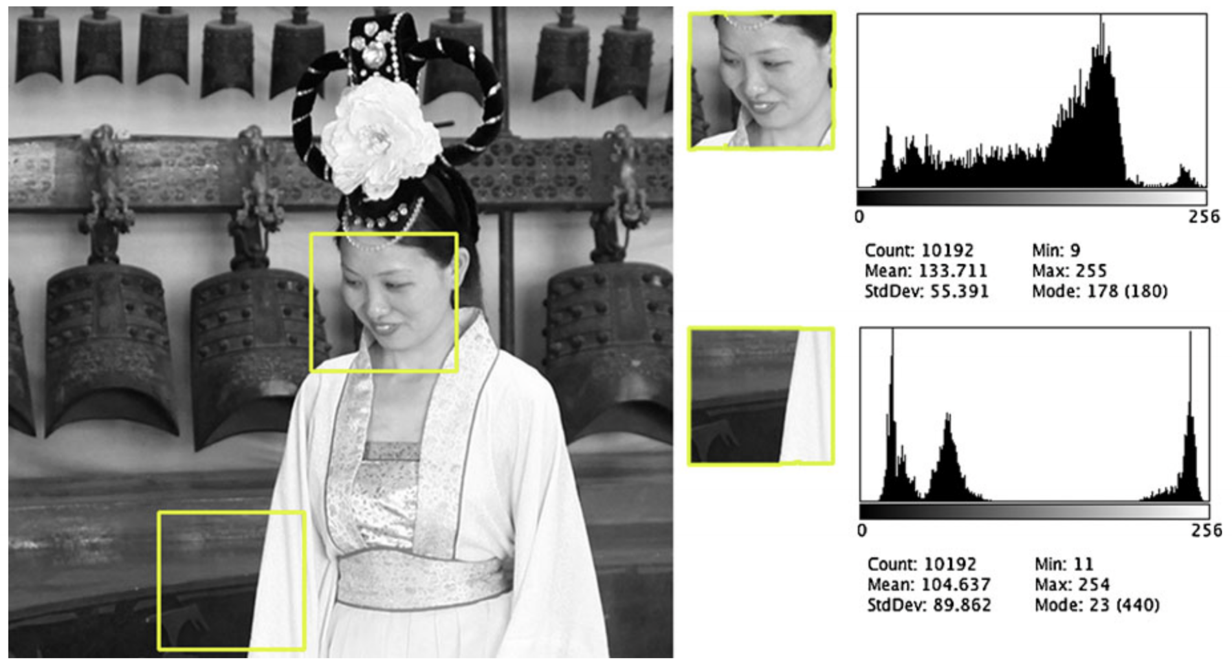
Histogram
Slide credit: Dr. Mubarak Shah

Slide 15
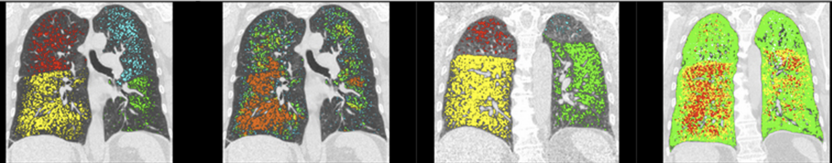
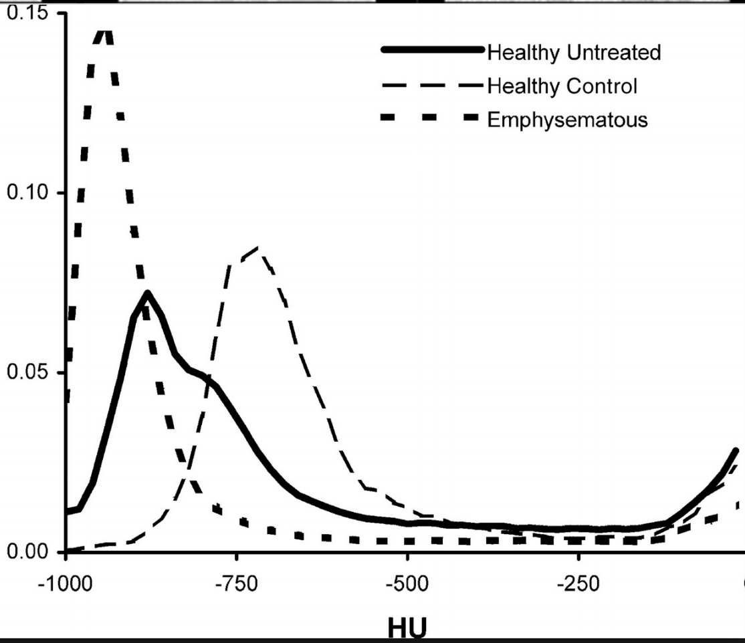
Histogram – use case
Slide credit: Dr. Mubarak Shah

Slide 16
What we will learn today?
Image sampling and quantization
Image histograms
Images as functions
Linear systems (filters)
Convolution and correlation
Some background reading:
Forsyth and Ponce, Computer Vision, Chapter 7

Slide 17
Systems and Filters
Filtering:
Forming a new image whose pixel values are transformed from original pixel values
Goals:
Goal is to extract useful information from images, or transform images into another domain where we can modify/enhance image properties
Features (edges, corners, blobs…)
super-resolution; in-painting; de-noising

Slide 18
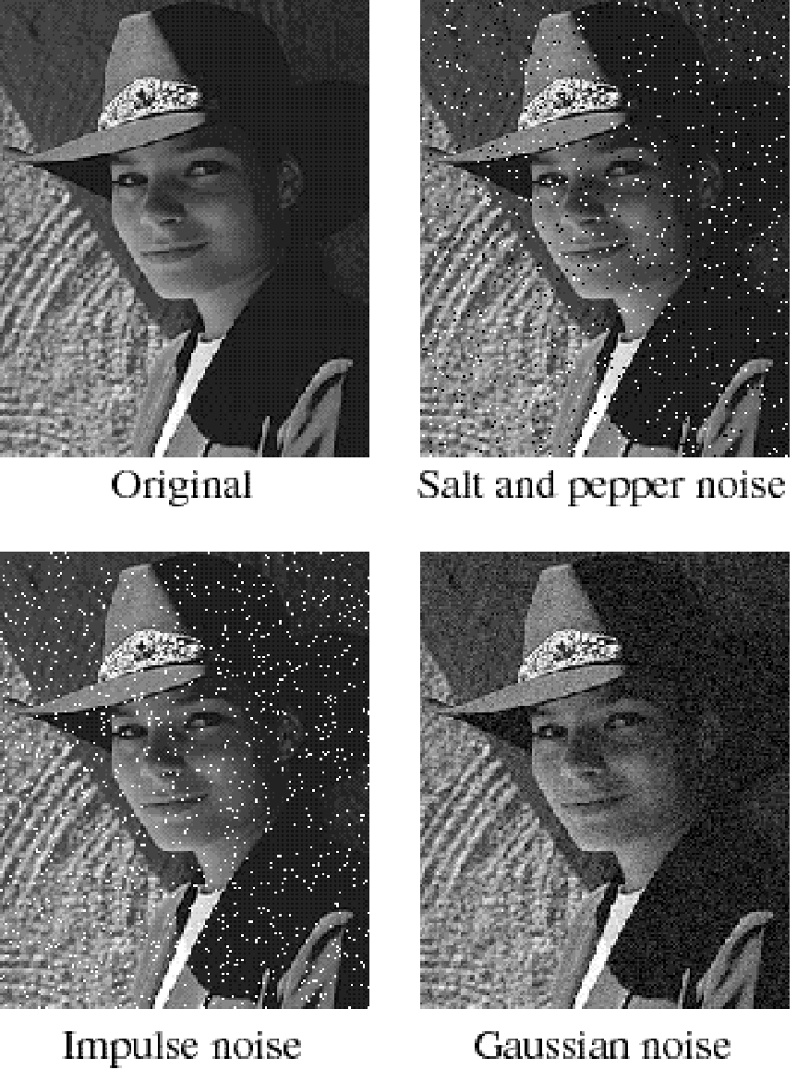
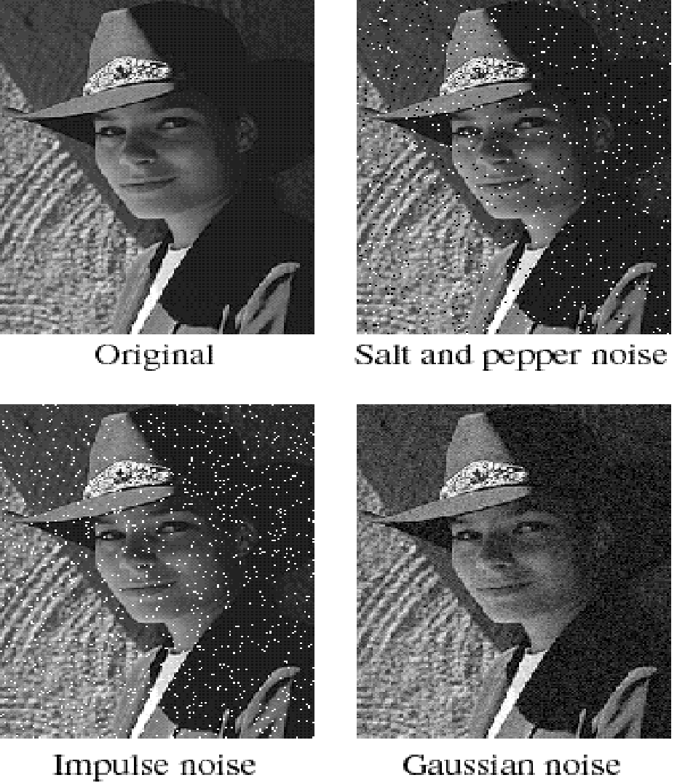
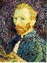
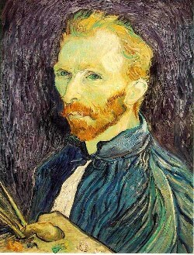
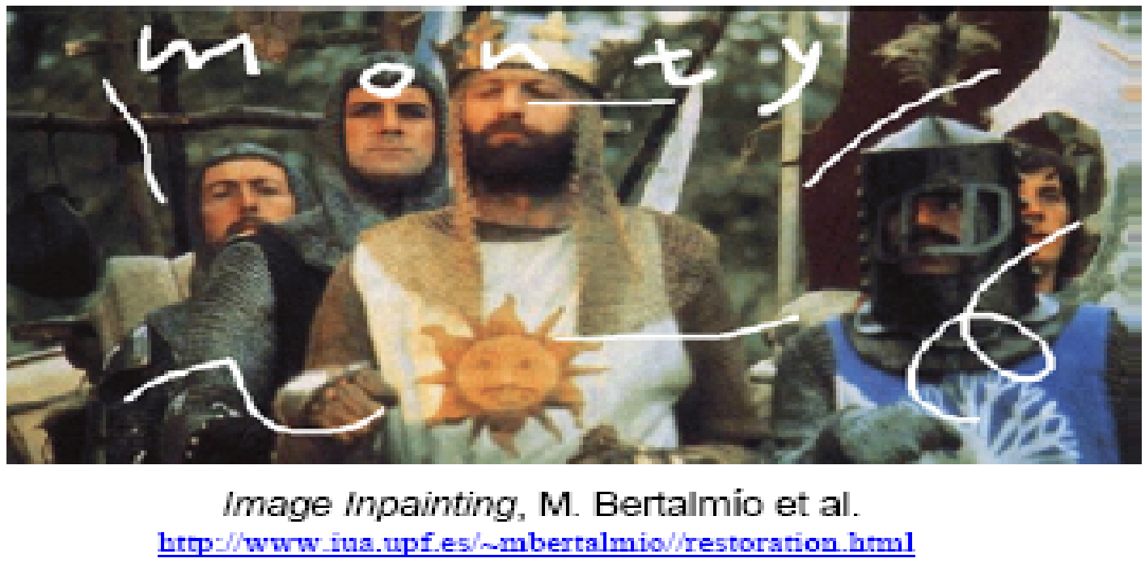
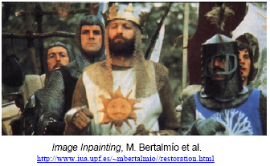
Super-resolution
De-noising
In-painting
Bertamio et al

Slide 19
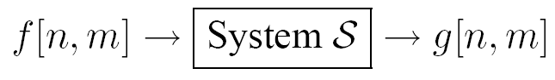
System and Filters
we define a system as a unit that converts an input function f[n,m] into an output (or response) function g[n,m], where (n,m) are the independent variables.
In the case for images, (n,m) represents the spatial position in the image.

Slide 20
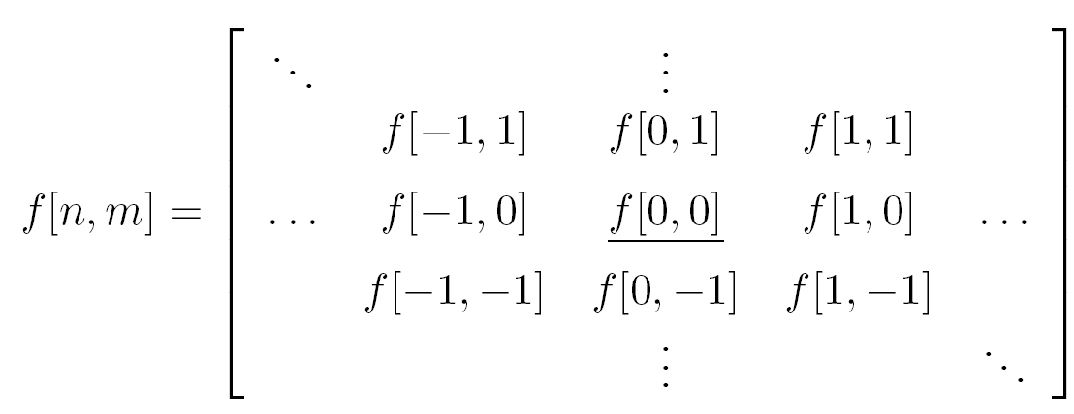
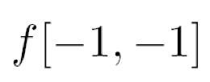
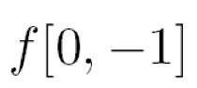
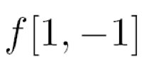
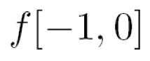
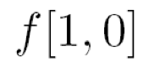
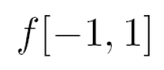
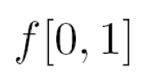
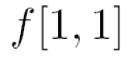
Images as coordinates
Cartesian coordinates
Notation for
discrete
functions

Slide 21
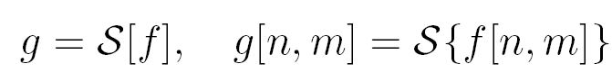
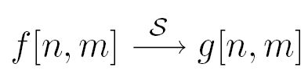
2D discrete-space systems (filters)
S is the system operator, defined as a mapping or assignment of a member of the set of possible outputs g[n,m] to each member of the set of possible inputs f[n,m].

Slide 22
Filter example #1: Moving Average

Slide 23
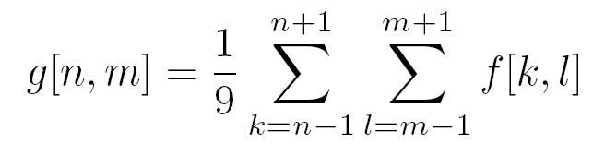

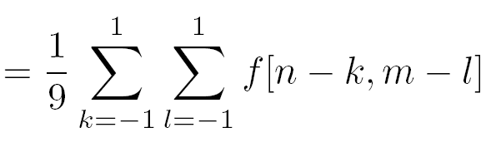
Filter example #1: Moving Average
2D DS moving average over a 3 × 3 window of neighborhood
h
1
1
1
1
1
1
1
1
1
Notes:
Board:
Input image
Output image
each pixel results from a neighborhood operation

Slide 24
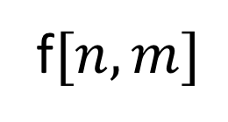
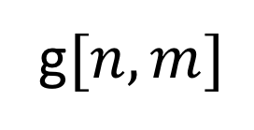
Filter example #1: Moving Average
0 | 0 | 0 | 0 | 0 | 0 | 0 | 0 | 0 | 0
0 | 0 | 0 | 0 | 0 | 0 | 0 | 0 | 0 | 0
0 | 0 | 0 | 90 | 90 | 90 | 90 | 90 | 0 | 0
0 | 0 | 0 | 90 | 90 | 90 | 90 | 90 | 0 | 0
0 | 0 | 0 | 90 | 90 | 90 | 90 | 90 | 0 | 0
0 | 0 | 0 | 90 | 0 | 90 | 90 | 90 | 0 | 0
0 | 0 | 0 | 90 | 90 | 90 | 90 | 90 | 0 | 0
0 | 0 | 0 | 0 | 0 | 0 | 0 | 0 | 0 | 0
0 | 0 | 90 | 0 | 0 | 0 | 0 | 0 | 0 | 0
0 | 0 | 0 | 0 | 0 | 0 | 0 | 0 | 0 | 0
 | 0
0 | 0 | 0 | 0 | 0 | 0 | 0 | 0 | 0 | 0
0 | 0 | 0 | 0 | 0 | 0 | 0 | 0 | 0 | 0
0 | 0 | 0 | 90 | 90 | 90 | 90 | 90 | 0 | 0
0 | 0 | 0 | 90 | 90 | 90 | 90 | 90 | 0 | 0
0 | 0 | 0 | 90 | 90 | 90 | 90 | 90 | 0 | 0
0 | 0 | 0 | 90 | 0 | 90 | 90 | 90 | 0 | 0
0 | 0 | 0 | 90 | 90 | 90 | 90 | 90 | 0 | 0
0 | 0 | 0 | 0 | 0 | 0 | 0 | 0 | 0 | 0
0 | 0 | 90 | 0 | 0 | 0 | 0 | 0 | 0 | 0
0 | 0 | 0 | 0 | 0 | 0 | 0 | 0 | 0 | 0
Courtesy of S. Seitz

Slide 25
Filter example #1: Moving Average
0 | 0 | 0 | 0 | 0 | 0 | 0 | 0 | 0 | 0
0 | 0 | 0 | 0 | 0 | 0 | 0 | 0 | 0 | 0
0 | 0 | 0 | 90 | 90 | 90 | 90 | 90 | 0 | 0
0 | 0 | 0 | 90 | 90 | 90 | 90 | 90 | 0 | 0
0 | 0 | 0 | 90 | 90 | 90 | 90 | 90 | 0 | 0
0 | 0 | 0 | 90 | 0 | 90 | 90 | 90 | 0 | 0
0 | 0 | 0 | 90 | 90 | 90 | 90 | 90 | 0 | 0
0 | 0 | 0 | 0 | 0 | 0 | 0 | 0 | 0 | 0
0 | 0 | 90 | 0 | 0 | 0 | 0 | 0 | 0 | 0
0 | 0 | 0 | 0 | 0 | 0 | 0 | 0 | 0 | 0
 | 0 | 10
0 | 0 | 0 | 0 | 0 | 0 | 0 | 0 | 0 | 0
0 | 0 | 0 | 0 | 0 | 0 | 0 | 0 | 0 | 0
0 | 0 | 0 | 90 | 90 | 90 | 90 | 90 | 0 | 0
0 | 0 | 0 | 90 | 90 | 90 | 90 | 90 | 0 | 0
0 | 0 | 0 | 90 | 90 | 90 | 90 | 90 | 0 | 0
0 | 0 | 0 | 90 | 0 | 90 | 90 | 90 | 0 | 0
0 | 0 | 0 | 90 | 90 | 90 | 90 | 90 | 0 | 0
0 | 0 | 0 | 0 | 0 | 0 | 0 | 0 | 0 | 0
0 | 0 | 90 | 0 | 0 | 0 | 0 | 0 | 0 | 0
0 | 0 | 0 | 0 | 0 | 0 | 0 | 0 | 0 | 0
‹#›

Slide 26
Filter example #1: Moving Average
0 | 0 | 0 | 0 | 0 | 0 | 0 | 0 | 0 | 0
0 | 0 | 0 | 0 | 0 | 0 | 0 | 0 | 0 | 0
0 | 0 | 0 | 90 | 90 | 90 | 90 | 90 | 0 | 0
0 | 0 | 0 | 90 | 90 | 90 | 90 | 90 | 0 | 0
0 | 0 | 0 | 90 | 90 | 90 | 90 | 90 | 0 | 0
0 | 0 | 0 | 90 | 0 | 90 | 90 | 90 | 0 | 0
0 | 0 | 0 | 90 | 90 | 90 | 90 | 90 | 0 | 0
0 | 0 | 0 | 0 | 0 | 0 | 0 | 0 | 0 | 0
0 | 0 | 90 | 0 | 0 | 0 | 0 | 0 | 0 | 0
0 | 0 | 0 | 0 | 0 | 0 | 0 | 0 | 0 | 0
 | 0 | 10 | 20
0 | 0 | 0 | 0 | 0 | 0 | 0 | 0 | 0 | 0
0 | 0 | 0 | 0 | 0 | 0 | 0 | 0 | 0 | 0
0 | 0 | 0 | 90 | 90 | 90 | 90 | 90 | 0 | 0
0 | 0 | 0 | 90 | 90 | 90 | 90 | 90 | 0 | 0
0 | 0 | 0 | 90 | 90 | 90 | 90 | 90 | 0 | 0
0 | 0 | 0 | 90 | 0 | 90 | 90 | 90 | 0 | 0
0 | 0 | 0 | 90 | 90 | 90 | 90 | 90 | 0 | 0
0 | 0 | 0 | 0 | 0 | 0 | 0 | 0 | 0 | 0
0 | 0 | 90 | 0 | 0 | 0 | 0 | 0 | 0 | 0
0 | 0 | 0 | 0 | 0 | 0 | 0 | 0 | 0 | 0

Slide 27
Filter example #1: Moving Average
0 | 0 | 0 | 0 | 0 | 0 | 0 | 0 | 0 | 0
0 | 0 | 0 | 0 | 0 | 0 | 0 | 0 | 0 | 0
0 | 0 | 0 | 90 | 90 | 90 | 90 | 90 | 0 | 0
0 | 0 | 0 | 90 | 90 | 90 | 90 | 90 | 0 | 0
0 | 0 | 0 | 90 | 90 | 90 | 90 | 90 | 0 | 0
0 | 0 | 0 | 90 | 0 | 90 | 90 | 90 | 0 | 0
0 | 0 | 0 | 90 | 90 | 90 | 90 | 90 | 0 | 0
0 | 0 | 0 | 0 | 0 | 0 | 0 | 0 | 0 | 0
0 | 0 | 90 | 0 | 0 | 0 | 0 | 0 | 0 | 0
0 | 0 | 0 | 0 | 0 | 0 | 0 | 0 | 0 | 0
 | 0 | 10 | 20 | 30
0 | 0 | 0 | 0 | 0 | 0 | 0 | 0 | 0 | 0
0 | 0 | 0 | 0 | 0 | 0 | 0 | 0 | 0 | 0
0 | 0 | 0 | 90 | 90 | 90 | 90 | 90 | 0 | 0
0 | 0 | 0 | 90 | 90 | 90 | 90 | 90 | 0 | 0
0 | 0 | 0 | 90 | 90 | 90 | 90 | 90 | 0 | 0
0 | 0 | 0 | 90 | 0 | 90 | 90 | 90 | 0 | 0
0 | 0 | 0 | 90 | 90 | 90 | 90 | 90 | 0 | 0
0 | 0 | 0 | 0 | 0 | 0 | 0 | 0 | 0 | 0
0 | 0 | 90 | 0 | 0 | 0 | 0 | 0 | 0 | 0
0 | 0 | 0 | 0 | 0 | 0 | 0 | 0 | 0 | 0

Slide 28
Filter example #1: Moving Average
0 | 0 | 0 | 0 | 0 | 0 | 0 | 0 | 0 | 0
0 | 0 | 0 | 0 | 0 | 0 | 0 | 0 | 0 | 0
0 | 0 | 0 | 90 | 90 | 90 | 90 | 90 | 0 | 0
0 | 0 | 0 | 90 | 90 | 90 | 90 | 90 | 0 | 0
0 | 0 | 0 | 90 | 90 | 90 | 90 | 90 | 0 | 0
0 | 0 | 0 | 90 | 0 | 90 | 90 | 90 | 0 | 0
0 | 0 | 0 | 90 | 90 | 90 | 90 | 90 | 0 | 0
0 | 0 | 0 | 0 | 0 | 0 | 0 | 0 | 0 | 0
0 | 0 | 90 | 0 | 0 | 0 | 0 | 0 | 0 | 0
0 | 0 | 0 | 0 | 0 | 0 | 0 | 0 | 0 | 0
 | 0 | 10 | 20 | 30 | 30

Slide 29
Filter example #1: Moving Average
0 | 0 | 0 | 0 | 0 | 0 | 0 | 0 | 0 | 0
0 | 0 | 0 | 0 | 0 | 0 | 0 | 0 | 0 | 0
0 | 0 | 0 | 90 | 90 | 90 | 90 | 90 | 0 | 0
0 | 0 | 0 | 90 | 90 | 90 | 90 | 90 | 0 | 0
0 | 0 | 0 | 90 | 90 | 90 | 90 | 90 | 0 | 0
0 | 0 | 0 | 90 | 0 | 90 | 90 | 90 | 0 | 0
0 | 0 | 0 | 90 | 90 | 90 | 90 | 90 | 0 | 0
0 | 0 | 0 | 0 | 0 | 0 | 0 | 0 | 0 | 0
0 | 0 | 90 | 0 | 0 | 0 | 0 | 0 | 0 | 0
0 | 0 | 0 | 0 | 0 | 0 | 0 | 0 | 0 | 0
 | 0 | 10 | 20 | 30 | 30 | 30 | 20 | 10
 | 0 | 20 | 40 | 60 | 60 | 60 | 40 | 20
 | 0 | 30 | 60 | 90 | 90 | 90 | 60 | 30
 | 0 | 30 | 50 | 80 | 80 | 90 | 60 | 30
 | 0 | 30 | 50 | 80 | 80 | 90 | 60 | 30
 | 0 | 20 | 30 | 50 | 50 | 60 | 40 | 20
 | 10 | 20 | 30 | 30 | 30 | 30 | 20 | 10
 | 10 | 10 | 10 | 0 | 0 | 0 | 0 | 0
Notes:
What is the effect on the output?
What happens to the sharp edges?

Slide 30

Filter example #1: Moving Average
In summary:
This filter creates a new pixel with an average of its neighborhood.
Achieve smoothing effect (remove sharp features)
1
1
1
1
1
1
1
1
1

Slide 31
Filter example #1: Moving Average

